Slide 1
Projective Geometry & Homography
Chul Min Yeum
Assistant Professor
Civil and Environmental Engineering
University of Waterloo, Canada
CIVE 497 – CIVE 700: Smart Structure Technology
Last updated: 2018-01-31

Slide 2

ON 3D-CameraMeasure App
Android: https://play.google.com/store/apps/details?id=com.potatotree.on3dcamerameasure

Slide 3

Microsoft Lens

Slide 4
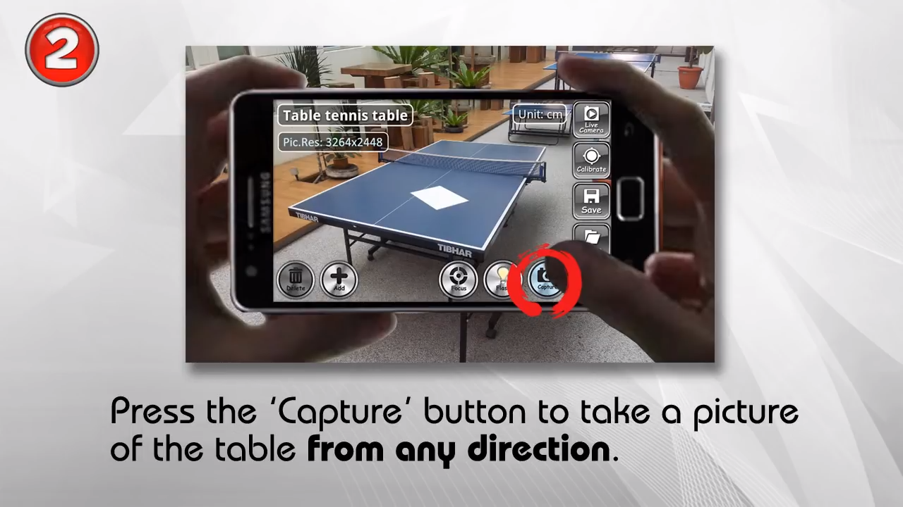
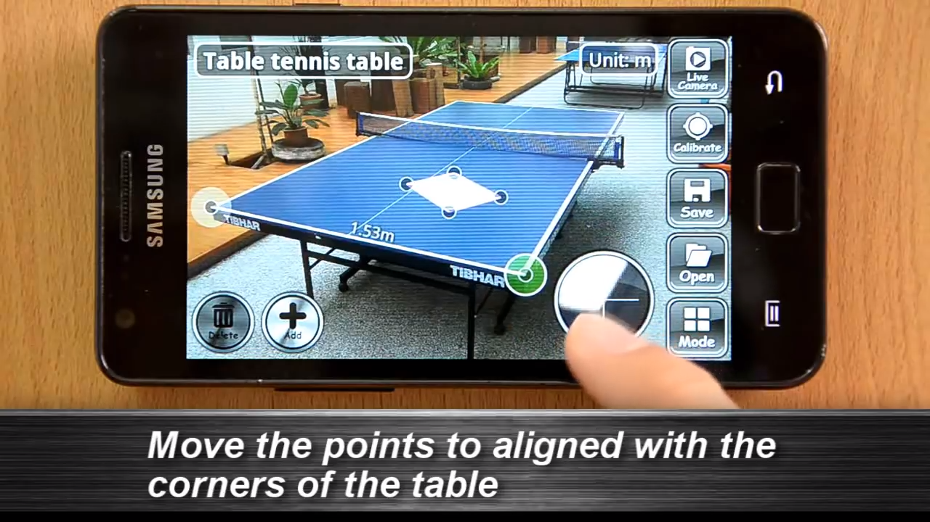
Measurement Demo

Slide 5

Measurement Demo (Continue)

Slide 6
Projective Geometry I and II
We will study this topic using
ECE 661: Computer Vision (by Avinash Kak)
Lecture 2: World 2D: Representing and Manipulating Points, Lines And Conics Using Homogeneous Coordinates
Lecture 3: World 2D: Projective Transformations and Transformation Groups
Lecture 4: Characterization of Distortions Caused by Projective Imaging and the Principle of Point/Line Duality
Lecture 5: Estimating a Plane-to-Plane Homography with Angle-to-Angle and Point-to-Point Correspondences
Course website: https://engineering.purdue.edu/kak/computervision/ECE661Folder/

Slide 7
Lecture 2: World 2D: Representing and Manipulating Points, Lines And Conics Using Homogeneous Coordinates

Slide 8
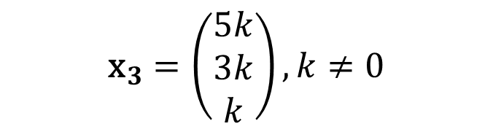
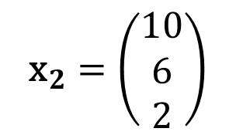
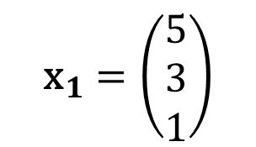

2-1: Point in the Homogeneous Coordinate
An arbitrary homogeneous vector representative of a point is of the form $\text{x}={\left(x_{1},x_{2},x_{3}\right)}^{T}$, representing the point ${\left(x_{1}/x_{3},x_{2}/x_{3}\right)}^{T} \text{in} ℝ^{2}$.
$${\text{x}}_{1}=\left(\begin{matrix}5 \\ 3 \\ 1\end{matrix}\right)$$
$${\text{x}}_{2}=\left(\begin{matrix}10 \\ 6 \\ 2\end{matrix}\right)$$
$${\text{x}}_{3}=\left(\begin{matrix}5k \\ 3k \\ k\end{matrix}\right),k≠0$$
Example)
up to a scale
${\text{x}}_{1},$ ${\text{x}}_{2}$, and ${\text{x}}_{3}$ indicate the same point of (5, 3) in $ℝ^{2}$
$ℝ^{n}$: n-dimension real coordinate system
Notes:
Euclidean space: https://en.wikipedia.org/wiki/Euclidean_space
“ X1 is equal to X3 up to scale”

Slide 9

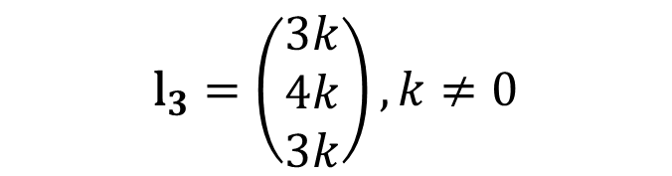

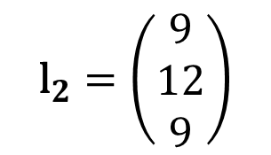
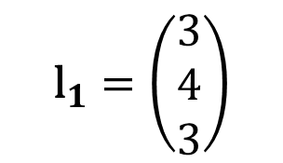

2-1: Line in the Homogeneous Coordinate (HC)
$$ax+by+c=0$$
$$\text{l}={\left(a,b,c\right)}^{⊺}$$
Line equation in $ℝ^{2}$
Line representation in HC
$${\text{l}}_{1}=\left(\begin{matrix}3 \\ 4 \\ 3\end{matrix}\right)$$
$${\text{l}}_{2}=\left(\begin{matrix}9 \\ 12 \\ 9\end{matrix}\right)$$
$${\text{l}}_{3}=\left(\begin{matrix}3k \\ 4k \\ 3k\end{matrix}\right),k≠0$$
Example)
${\text{x}}_{1},$ ${\text{x}}_{2}$, and ${\text{x}}_{3}$ indicate the same line of $3x+4y+3=0$ in $ℝ^{2}$

Slide 10
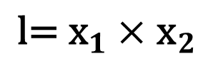

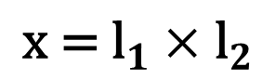
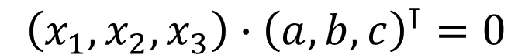
2-1: Points and Lines in the Homogeneous Coordinate (HC)
$$ax+by+c=0$$
$${\left(x_{1},x_{2},x_{3}\right)∙\left(a,b,c\right)}^{⊺}=0$$
The point $\text{x}$ lies on the line $\text{l}$ if and only if $\text{x}{\text{l}}^{⊺}$ =$\text{l}{\text{x}}^{⊺}$= 0.
Given any two lines ${\text{l}}_{1}=(a_{1},b_{1},c_{1})$ and ${\text{l}}_{1}=\left(a_{2},b_{2},c_{2}\right)$, the point ($\text{x}$) of intersection of the two lines :
$${\text{x}\text{ = }\text{l}}_{1}×{\text{l}}_{2}$$
Given any two points ${\text{x}}_{1}=(x_{1},y_{1},z_{1})$ and ${\text{x}}_{2}=\left(x_{2},y_{2},z_{2}\right)$, the line ($\text{l}$) that passes through the two points :
$${\text{l}\text{= }\text{x}}_{1}×{\text{x}}_{2}$$

Slide 11
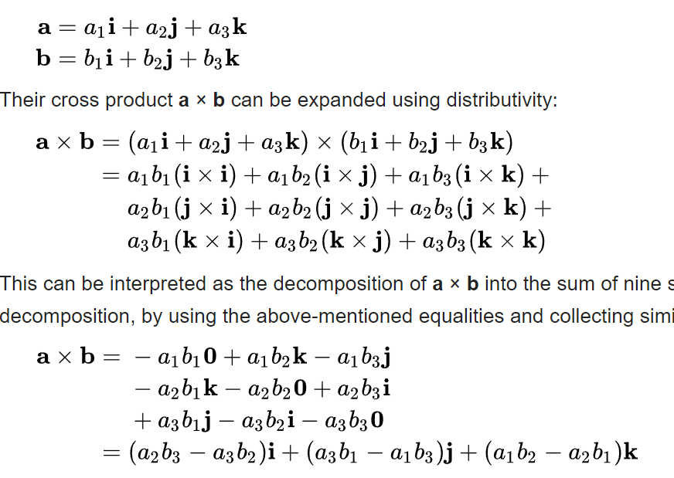
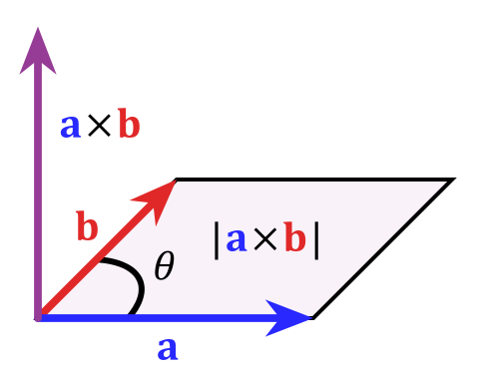
Cross Product
https://en.wikipedia.org/wiki/Cross_product

Slide 12
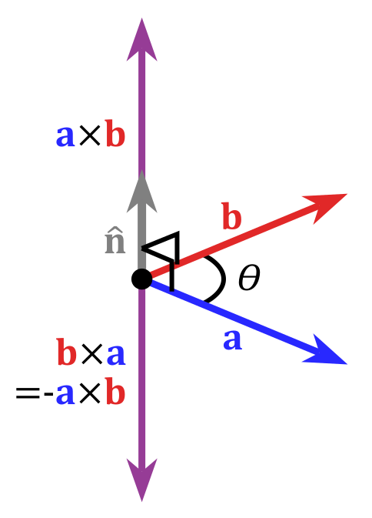
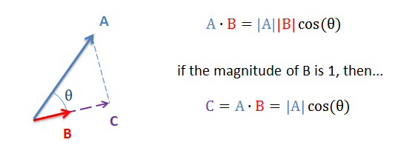
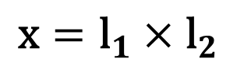
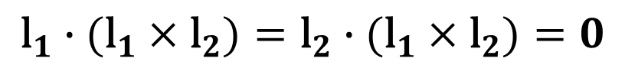
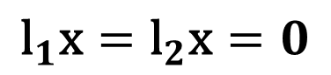
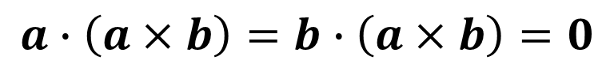
2-2: Prove the Relationship using the Triple Scalar Identity
Dot product
Cross product
$${\text{l}}_{1}\text{x}={\text{l}}_{2}\text{x}=0$$
$$a∙\left(a×b\right)=b∙\left(a×b\right)=0$$
$${\text{l}}_{1}∙({\text{l}}_{1}×{\text{l}}_{2})={\text{l}}_{2}∙({\text{l}}_{1}×{\text{l}}_{2})=0$$
$$\text{x}={\text{l}}_{1}×{\text{l}}_{2}$$
Notes:
https://en.wikipedia.org/wiki/Cross_product

Slide 13
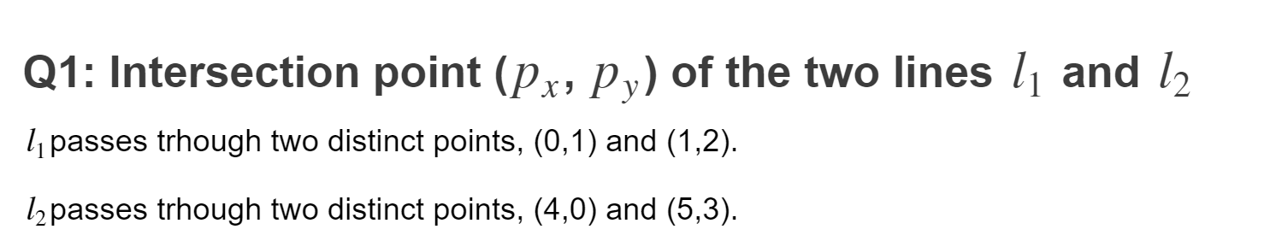
Quiz

Slide 14




2-1 & 2-2: Visualization of Points and Lines in the Homogeneous Coordinate
$$l_{1}$$
$$x_{1}$$
$$x_{2}$$
$$l_{2}$$

Slide 15
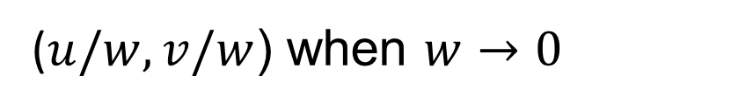
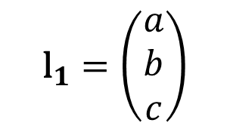
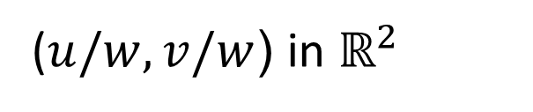
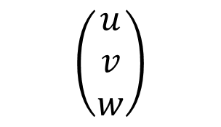
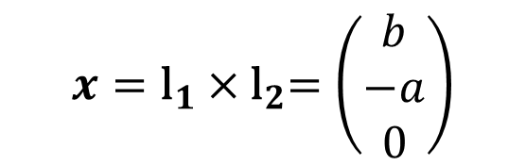
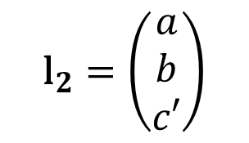
2-2: Ideal Points
$$x={\text{l}}_{1}{×\text{l}}_{2}=\left(\begin{matrix}b \\ −a \\ 0\end{matrix}\right)$$
$${\text{l}}_{1}=\left(\begin{matrix}a \\ b \\ c\end{matrix}\right)$$
$${\text{l}}_{2}=\left(\begin{matrix}a \\ b \\ c′\end{matrix}\right)$$
Ideal points
The point approach to infinity is along a specific direction and the direction being controlled by the value of u and v.
$$\left(\begin{matrix}u \\ v \\ w\end{matrix}\right)$$
($u/w,v/w$) in $ℝ^{2}$
Mathematically!!!
($u/w,v/w$) when $w→0$
Valid the point and line relationship
Notes:
http://juliannakunstler.com/art1_2pt_ch_board.html

Slide 16
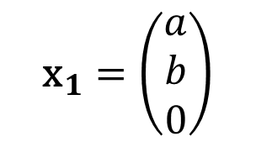
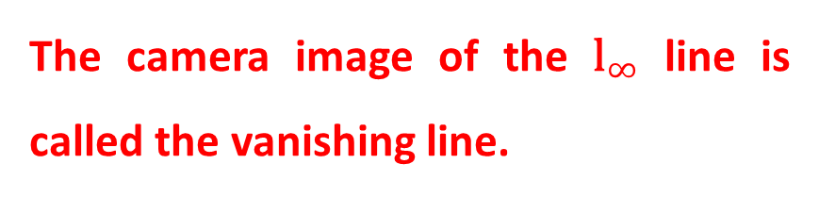

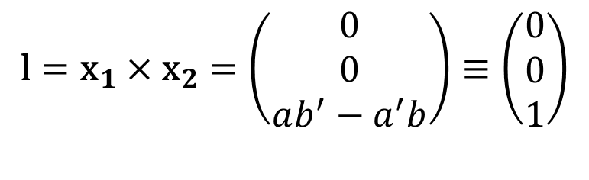
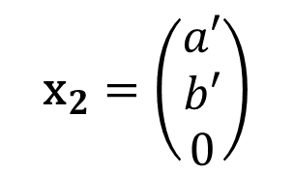
2-3: Vanishing Line
$${\text{x}}_{1}=\left(\begin{matrix}a \\ b \\ 0\end{matrix}\right)$$
$${\text{x}}_{2}=\left(\begin{matrix}a′ \\ b′ \\ 0\end{matrix}\right)$$
$$\text{l}={{\text{x}}_{1}×\text{x}}_{2}=\left(\begin{matrix}0 \\ 0 \\ ab^{′}−a^{′}b\end{matrix}\right)≡\left(\begin{matrix}0 \\ 0 \\ 1\end{matrix}\right)$$
$${\text{l}}_{∞}=\left(\begin{matrix}0 \\ 0 \\ 1\end{matrix}\right)$$
The camera image of the ${\text{l}}_{∞}$ line is called the vanishing line.
Line at infinity
Notes:
http://juliannakunstler.com/art1_2pt_ch_board.html

Slide 17
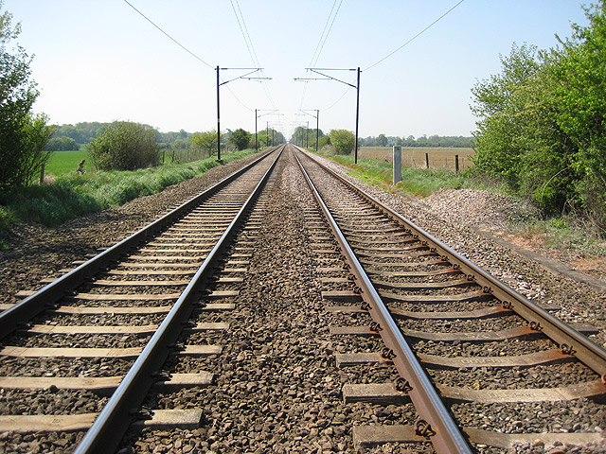
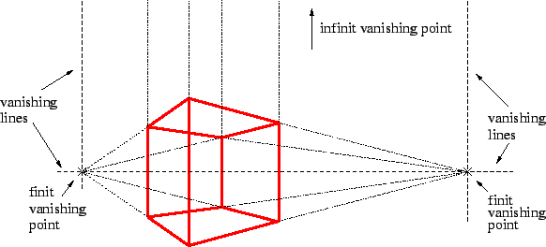
Vanishing Point and Line

Slide 18
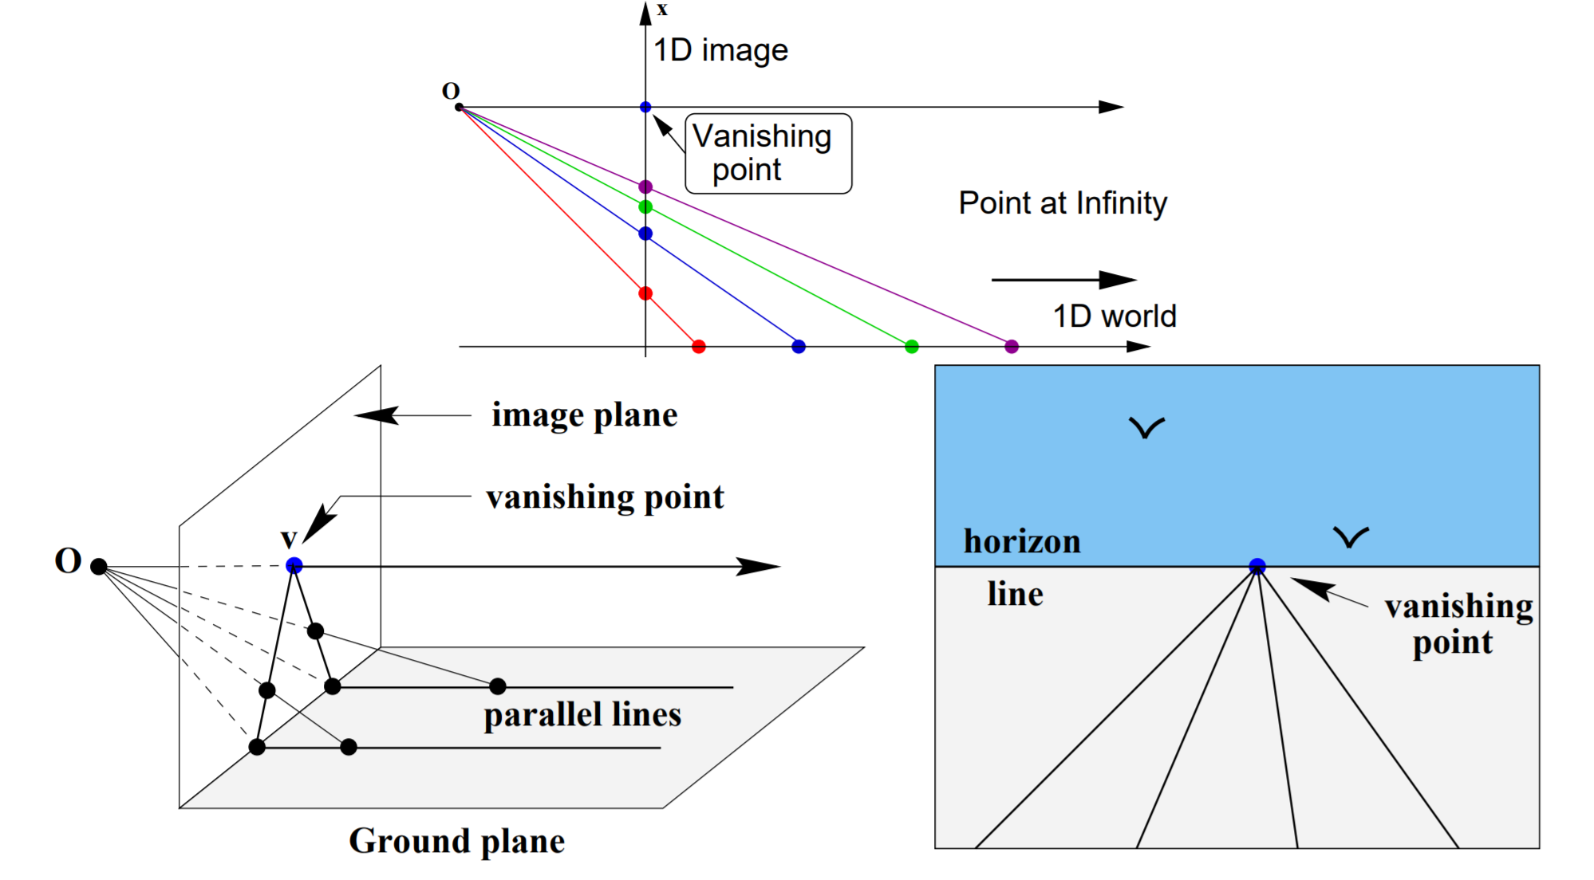
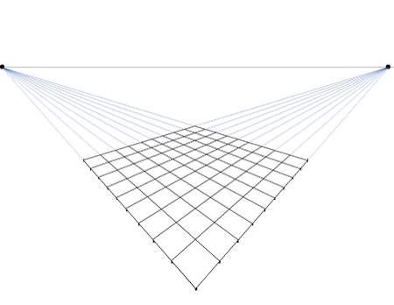
Why All Parallel Lines Meet at One Point?
Vanishing line

Slide 19
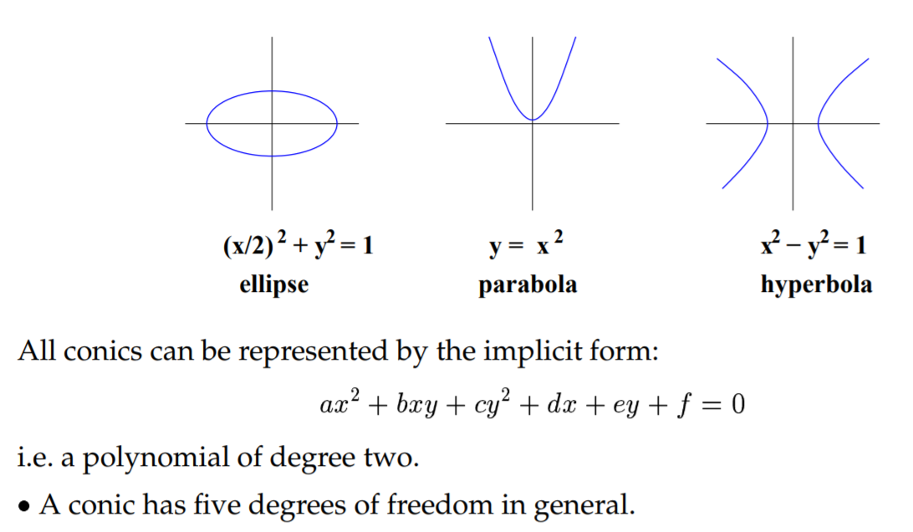
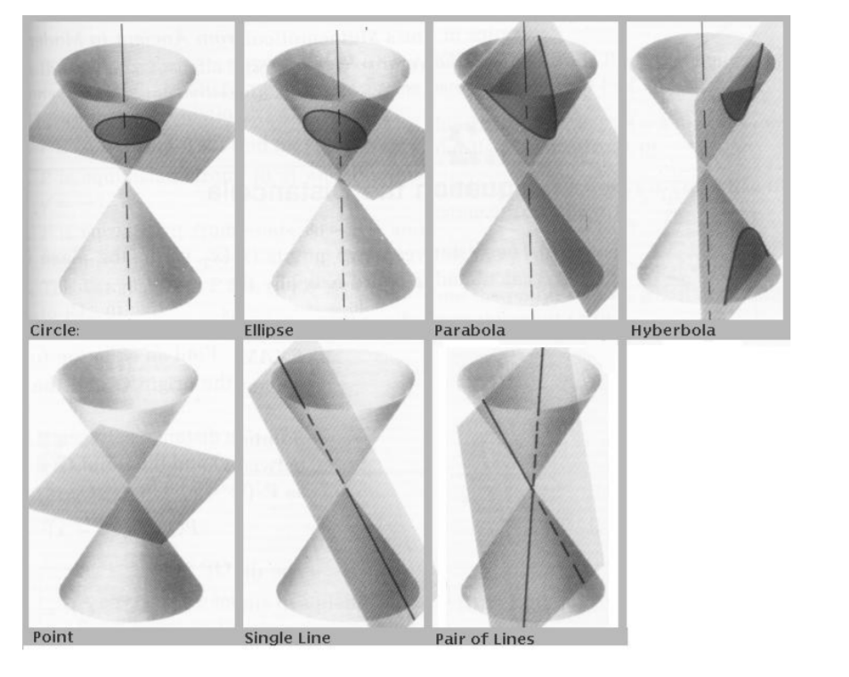
2-3: Conic
$$ax^{2}+b{xy+cy}^{2}+dx+ey+f=0$$
A conic has five degrees of freedom in general
x and y can be represented by the conic equation
Notes:
Implicit function: Implicit function is defined as a relationship between x and y. No distinction can be made between dependent and independent variable.
In other word, x and y can not be separated.
Explicit function: Here, dependent variable is expressed in terms of independent variable. In other word, x and y can be separated.

Slide 20

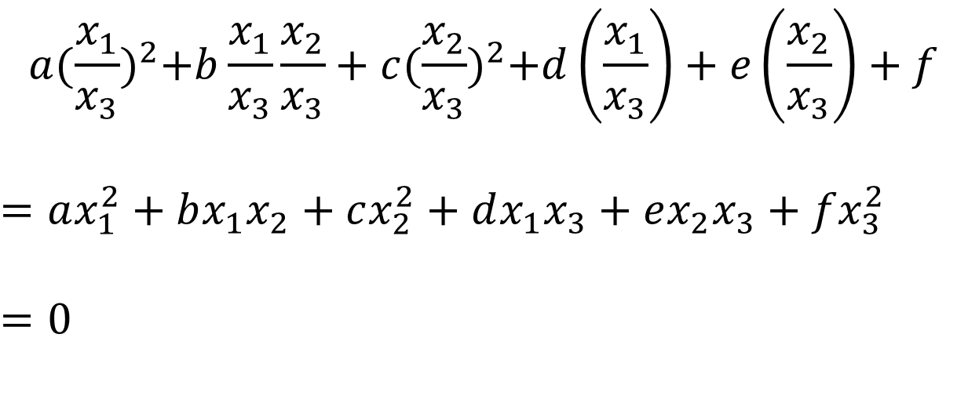

2-3: Conics in HC
$$ax^{2}+bxy+cy^{2}+dx+ey+f=0$$
$\left(x,y\right)$ in $ℝ^{2}$
$$a{(\frac{x_{1}}{x_{3}})}^{2}+b\frac{x_{1}}{x_{3}}\frac{x_{2}}{x_{3}}+c{(\frac{x_{2}}{x_{3}})}^{2}+d\left(\frac{x_{1}}{x_{3}}\right)+e\left(\frac{x_{2}}{x_{3}}\right)+f$$
$$=ax_{1}^{2}+bx_{1}x_{2}+cx_{2}^{2}+dx_{1}x_{3}+ex_{2}x_{3}+fx_{3}^{2}$$
$$=0$$
$\left(x_{1},x_{2},x_{3}\right)$ in $ℍℂ$

Slide 21
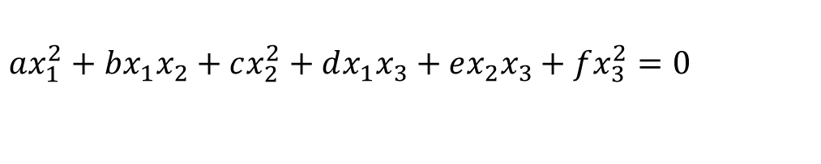

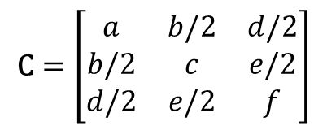
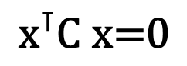
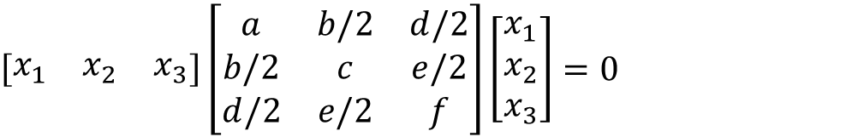
2-3: Conic in HC (Continue)
$$ax_{1}^{2}+bx_{1}x_{2}+cx_{2}^{2}+dx_{1}x_{3}+ex_{2}x_{3}+fx_{3}^{2}=0$$
$\left(x_{1},x_{2},x_{3}\right)$ in $ℍℂ$
$$\left[\begin{matrix}x_{1} & x_{2} & x_{3}\end{matrix}\right]\left[\begin{matrix}a & b/2 & d/2 \\ b/2 & c & e/2 \\ d/2 & e/2 & f\end{matrix}\right]\left[\begin{matrix}x_{1} \\ x_{2} \\ x_{3}\end{matrix}\right]=0$$
$$\text{C}=\left[\begin{matrix}a & b/2 & d/2 \\ b/2 & c & e/2 \\ d/2 & e/2 & f\end{matrix}\right]$$
$\text{C}$is the HC representation of a conic
$${\text{x}}^{⊺}\text{C} \text{x}\text{=0}$$

Slide 22
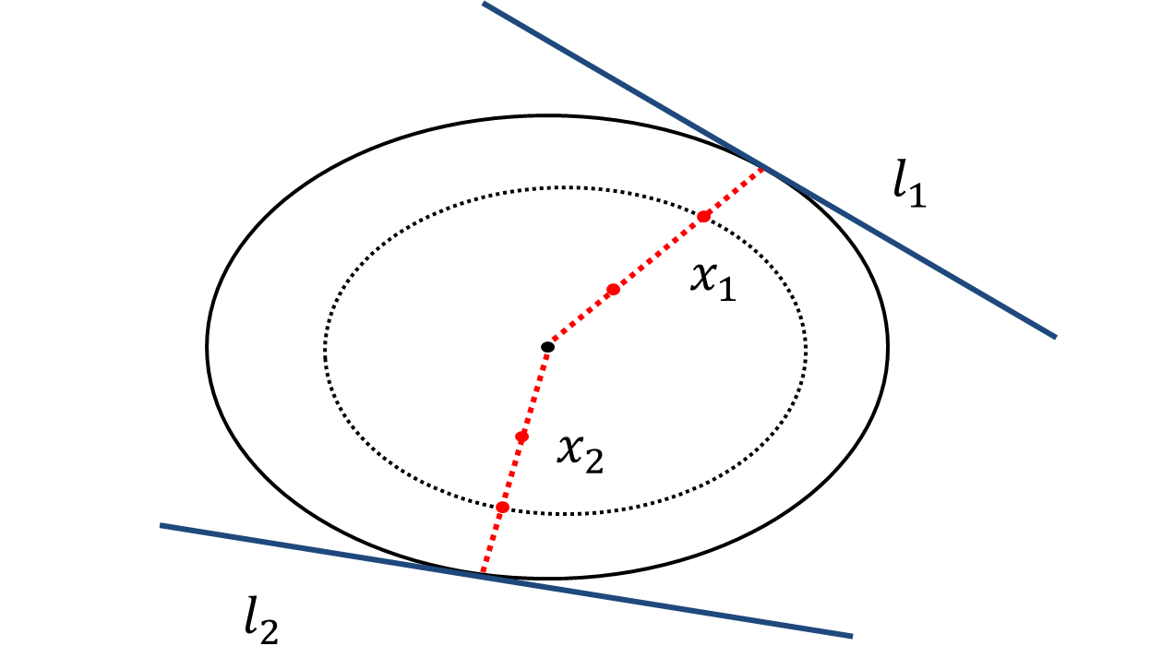
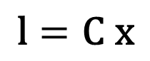
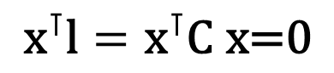
2-4: Conic Property
The HC representation of a conic gives us compact formulas for the tangent lines to a conic.
$${\text{x}}^{⊺}\text{l}={\text{x}}^{⊺}\text{C} \text{x}\text{=0}$$
$$\text{l}=\text{C} \text{x}$$

Slide 23
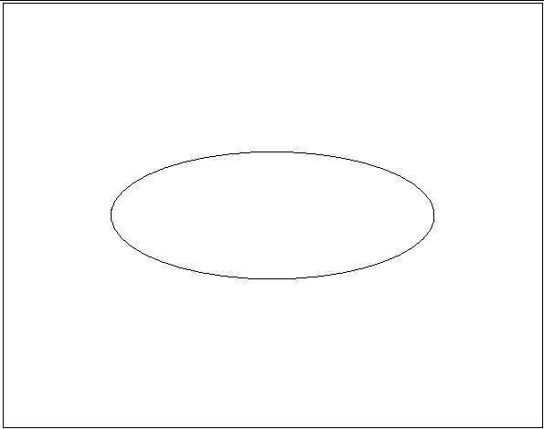
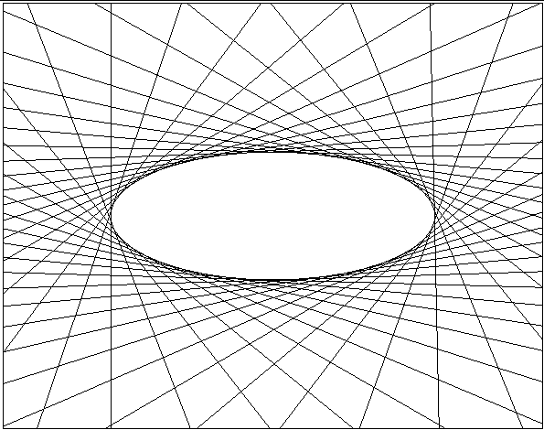
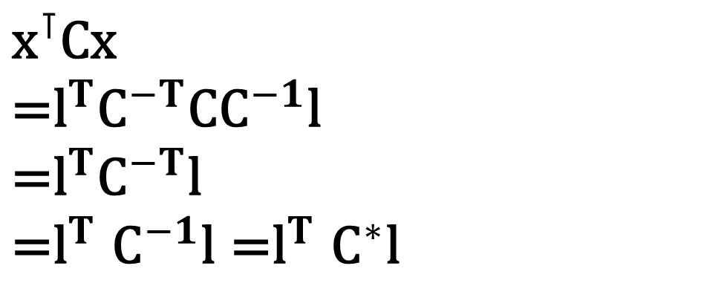
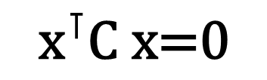
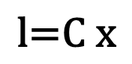
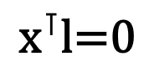
2-4: Dual Conic
$${\text{x}}^{⊺}\text{C}\text{x}$$
$$\text{=}{\text{l}}^{T}{\text{C}}^{−T}\text{C}{\text{C}}^{−1}\text{l}$$
$$\text{=}{\text{l}}^{T}{\text{C}}^{−T}\text{l}$$
$${\text{=}\text{l}}^{T}{\text{C}}^{−1}\text{l}{\text{=}\text{l}}^{T}{\text{C}}^{∗}\text{l}$$
$${\text{x}}^{⊺}\text{C} \text{x}\text{=0}$$
$${\text{x}}^{⊺}\text{l}\text{=0}$$
$$\text{l}\text{=}\text{C} \text{x}$$

Slide 24

2-4: Degenerate Conic
$$\text{C} \text{= }\text{l}{\text{m}}^{⊺ }\text{+ }\text{m}{\text{l}}^{⊺}$$
Two lines constitute a degenerate conic.
$${\text{x}}^{⊺}\text{C} \text{x}\text{=}{\text{x}}^{⊺}\text{(}\text{l}{\text{m}}^{⊺ }\text{+ }\text{m}{\text{l}}^{⊺})\text{x}\text{=0}$$
Two lines constitute a degenerate line conic.
$${\text{l}}^{⊺}{\text{C}}^{∗} \text{l}\text{=}{\text{l}}^{⊺}\text{(}\text{x}{\text{y}}^{⊺ }\text{+ }\text{x}{\text{y}}^{⊺})\text{x}\text{=0}$$

Slide 25


Quiz

Slide 26


Summary
1. An arbitrary homogeneous vector representative of a point is of the form $\text{x}={\left(x_{1},x_{2},x_{3}\right)}^{T}$, representing the point ${\left(x_{1}/x_{3},x_{2}/x_{3}\right)}^{T} \text{in} ℝ^{2}$.
2. Line equation, $ax+by+c=0$, in $ℝ^{2}$ is represented as $\text{l}={\left(a,b,c\right)}^{⊺}$ in the homogeneous coordinate.
3. A conic, $ax^{2}+bxy+cy^{2}+dx+ey+f=0$, in $ℝ^{2}$ become a 3x3 matrix, $\text{C}$, in the homogeneous coordinate,
$$\text{C}=\left[\begin{matrix}a & b/2 & d/2 \\ b/2 & c & e/2 \\ d/2 & e/2 & f\end{matrix}\right]$$

Slide 27
Lecture 3: World 2D: Projective Transformations and Transformation Groups

Slide 28


Pinhole Camera Model
https://en.wikipedia.org/wiki/Pinhole_camera_model

Slide 29



3-1: Projective Transformation
A planar projective transformation (homography) is a linear transformation on homogeneous 3-vectors, the transformation being represented by a non-singular 3x3 matrix H, as in
$$\left(\begin{matrix}x_{1}^{′} \\ x_{2}^{′} \\ x_{3}^{′}\end{matrix}\right)=\left[\begin{matrix}h_{11} & h_{12} & h_{13} \\ h_{21} & h_{22} & h_{23} \\ h_{31} & h_{32} & h_{33}\end{matrix}\right]\left(\begin{matrix}x_{1} \\ x_{2} \\ x_{3}\end{matrix}\right)$$
$$\text{x}\text{′}=\text{Hx}$$
Notes:
Theorem 2.10.

Slide 30

3-1: Projective Transformation (continue)
In planar perspective transformation, all rays that join a scene point $\text{x}$ with its corresponding image point $\text{x}$’ must pass through the same point that is referred to as the center of projection or the focal center. Obviously , an image formed with a planar perspective transformation will, in general, suffer from distortions including projective, affine, and similarity.

Slide 31







3-1: Property of a Homography
It always maps a straight line to a straight line.
$$\text{x}\text{′}=\text{Hx}$$
$${\text{l}\text{′}}^{⊺}\text{x}\text{′}={\text{l}\text{′}}^{⊺}\text{Hx}\text{ =}{\text{(}\text{l}\text{′}}^{⊺}\text{H}\text{)}\text{x}\text{=}\text{lx}\text{=0}$$
$${\text{l}\text{′}}^{⊺}\text{H}\text{=}\text{l}$$
$${\text{l}\text{′=}\text{H}}^{−⊺}\text{l}$$
Conics
$${\text{x}}^{⊺}\text{C} \text{x}$$
$$\text{=}{\text{(}{\text{H}}^{−1}\text{x}\text{′)}}^{⊺}\text{C}{\text{H}}^{−1}\text{x}\text{′}$$
$$\text{=}{\text{x}}^{′⊺}{\text{H}}^{−⊺}\text{C}{\text{H}}^{−1}\text{x}\text{′}$$
$$\text{=}{\text{x}}^{′⊺}{\text{C}}^{′}\text{x}\text{′}$$
$${\text{x}}^{⊺}\text{C} \text{x}\text{=0}$$

Slide 32
3-2: Hierarchy of Transformation
A similarity transform is an affine transform.
A projective transform is an affine transform.
An Euclidean transform is an affine transform.
An affine transform is an projective transform.
An similarity transform is an Euclidean transform.
Projective group
subgroup of
Affine group
subgroup of
Similarity group
subgroup of
Euclidean group

Slide 33







3-4: Geometric Transformation (Euclidean Transformation)
Rigid body motions
$$\left(\begin{matrix}x_{1}^{′} \\ x_{2}^{′} \\ x_{3}^{′}\end{matrix}\right)=\left[\begin{matrix}1 & 0 & t_{x} \\ 0 & 1 & t_{y} \\ 0 & 0 & 1\end{matrix}\right]\left(\begin{matrix}x_{1} \\ x_{2} \\ x_{3}\end{matrix}\right)$$
$$\text{x}\text{′}=\text{x}+\text{t}$$
$$\left(\begin{matrix}x_{1}^{′} \\ x_{2}^{′} \\ x_{3}^{′}\end{matrix}\right)=\left[\begin{matrix}cosθ & −sinθ & 0 \\ sinθ & cosθ & 0 \\ 0 & 0 & 1\end{matrix}\right]\left(\begin{matrix}x_{1} \\ x_{2} \\ x_{3}\end{matrix}\right)$$
$$\text{x}\text{′}=\text{Rx}$$
$$\left(\begin{matrix}x_{1}^{′} \\ x_{2}^{′} \\ x_{3}^{′}\end{matrix}\right)=\left[\begin{matrix}cosθ & −sinθ & t_{x} \\ sinθ & cosθ & t_{y} \\ 0 & 0 & 1\end{matrix}\right]\left(\begin{matrix}x_{1} \\ x_{2} \\ x_{3}\end{matrix}\right)$$
$$\text{x}\text{′}=\text{Rx}+\text{t}$$

Slide 34




3-4: Geometric Transformation (Similarity Transformation)
Preserve angles and ratios of lengths => Preserve “shape” (isotropic scale)
$$\left(\begin{matrix}x_{1}^{′} \\ x_{2}^{′} \\ x_{3}^{′}\end{matrix}\right)=\left[\begin{matrix}s & 0 & t_{x} \\ 0 & s & t_{y} \\ 0 & 0 & 1\end{matrix}\right]\left(\begin{matrix}x_{1} \\ x_{2} \\ x_{3}\end{matrix}\right)$$
$$\left(\begin{matrix}x_{1}^{′} \\ x_{2}^{′} \\ x_{3}^{′}\end{matrix}\right)=\left[\begin{matrix}s∗cosθ & −s∗sinθ & t_{x} \\ s∗sinθ & s∗cosθ & t_{y} \\ 0 & 0 & 1\end{matrix}\right]\left(\begin{matrix}x_{1} \\ x_{2} \\ x_{3}\end{matrix}\right)$$
$$\text{x}\text{′}=s\text{Rx}+\text{t}$$

Slide 35


3-3 & 3-4: Geometric Transformation (Affine Transformation)
Keep parallel lines parallel.
$$\left(\begin{matrix}x_{1}^{′} \\ x_{2}^{′} \\ x_{3}^{′}\end{matrix}\right)=\left[\begin{matrix}a_{11} & a_{12} & t_{x} \\ a_{21} & a_{22} & t_{y} \\ 0 & 0 & 1\end{matrix}\right]\left(\begin{matrix}x_{1} \\ x_{2} \\ x_{3}\end{matrix}\right)$$
$$\text{A}=\left[\begin{matrix}a_{11} & a_{12} \\ a_{21} & a_{22}\end{matrix}\right]$$

Slide 36


3-4: Algebraic Understanding on Affine Transformation
Singular value decomposition (SVD)
$$\text{A}\text{=}\text{UD}{\text{V}}^{\text{⊺}}\text{=(}\text{U}{\text{V}}^{\text{⊺}}\text{)(}{\text{VDV}}^{\text{⊺}}\text{)}\text{=}\text{R}\text{(}θ\text{)}\text{R}\text{(−}ϕ\text{)}\text{DR}\text{(}ϕ\text{)}$$
U, V: Orthonormal matrix
D: Diagonal matrix
Product of two orthonormal matrices become an orthonormal matrix
Every orthonormal matrix having determinant 1 acts as a rotation.
Notes:
https://math.stackexchange.com/questions/1416726/why-is-the-matrix-product-of-2-orthogonal-matrices-also-an-orthogonal-matrix

Slide 37



3-4: Algebraic Understanding on Affine Transformation
$$\text{A}\text{=}\text{UD}{\text{V}}^{\text{⊺}}\text{=(}\text{U}{\text{V}}^{\text{⊺}}\text{)(}{\text{VDV}}^{\text{⊺}}\text{)}\text{=}\text{R}\text{(}θ\text{)}\text{R}\text{(}ϕ\text{)}\left[\begin{matrix}λ_{1} & 0 \\ 0 & λ_{2}\end{matrix}\right]\text{R}\text{(}ϕ\text{)}$$
The affine matrix A is seen to be the concatenation of a rotation (by $φ$); a scaling by $λ_{1}$ and $λ_{2}$ respectively in the (rotated) x and y directions ; a rotation back (by $−φ$); and finally another rotation (by $θ$). The only “new” geometry, compared to a similarity, is the non-isotropic scaling.
Notes:
https://math.stackexchange.com/questions/1416726/why-is-the-matrix-product-of-2-orthogonal-matrices-also-an-orthogonal-matrix

Slide 38



3-4: Geometric Transformation (Projective Transformation)
$$\left(\begin{matrix}x_{1}^{′} \\ x_{2}^{′} \\ x_{3}^{′}\end{matrix}\right)=\left[\begin{matrix}h_{11} & h_{12} & h_{13} \\ h_{21} & h_{22} & h_{23} \\ h_{31} & h_{32} & h_{33}\end{matrix}\right]\left(\begin{matrix}x_{1} \\ x_{2} \\ x_{3}\end{matrix}\right)$$
$$Cross ratio$$

Slide 39



3-4: Decomposition of a Project Transformation
$$\left(\begin{matrix}x_{1}^{′} \\ x_{2}^{′} \\ x_{3}^{′}\end{matrix}\right)=\left[\begin{matrix}s∗cosθ & −s∗sinθ & t_{x} \\ s∗sinθ & s∗cosθ & t_{y} \\ 0 & 0 & 1\end{matrix}\right]\left(\begin{matrix}x_{1} \\ x_{2} \\ x_{3}\end{matrix}\right)=\left[\begin{matrix}\text{s}\text{R} & \text{t} \\ {\text{0}}^{\text{⊺}} & 1\end{matrix}\right]\left(\begin{matrix}x_{1} \\ x_{2} \\ x_{3}\end{matrix}\right)$$
Similarity
$$\left(\begin{matrix}x_{1}^{′} \\ x_{2}^{′} \\ x_{3}^{′}\end{matrix}\right)=\left[\begin{matrix}a_{11} & a_{12} & t_{x} \\ a_{21} & a_{22} & t_{y} \\ 0 & 0 & 1\end{matrix}\right]\left(\begin{matrix}x_{1} \\ x_{2} \\ x_{3}\end{matrix}\right)$$
Affine
$$\text{H}\text{=}{\text{H}}_{S}{\text{H}}_{A}{\text{H}}_{P}=\left[\begin{matrix}\text{s}\text{R} & \text{t} \\ {\text{0}}^{\text{⊺}} & 1\end{matrix}\right]\left[\begin{matrix}K & \text{0} \\ {\text{0}}^{\text{⊺}} & 1\end{matrix}\right]\left[\begin{matrix}I & \text{0} \\ {\text{v}}^{\text{⊺}} & v\end{matrix}\right]$$

Slide 40


3-4: Decomposition of a Project Transformation (Continue)
$$\text{H}\text{=}{\text{H}}_{S}{\text{H}}_{A}{\text{H}}_{P}=\left[\begin{matrix}\text{s}\text{R} & \text{t} \\ {\text{0}}^{\text{⊺}} & 1\end{matrix}\right]\left[\begin{matrix}K & \text{0} \\ {\text{0}}^{\text{⊺}} & 1\end{matrix}\right]\left[\begin{matrix}I & \text{0} \\ {\text{v}}^{\text{⊺}} & v\end{matrix}\right]$$
$${\text{H}}^{−1}\text{=}{{\text{H}}_{P}}^{−1}{{\text{H}}_{A}}^{−1}{{\text{H}}_{S}}^{−1}$$
$$\text{H}\text{=}{\text{H}}_{P}{\text{H}}_{A}{\text{H}}_{S}=\left[\begin{matrix}I & \text{0} \\ {\text{v}}^{\text{⊺}} & v\end{matrix}\right]\left[\begin{matrix}K & \text{0} \\ {\text{0}}^{\text{⊺}} & 1\end{matrix}\right]\left[\begin{matrix}\text{s}\text{R} & \text{t} \\ {\text{0}}^{\text{⊺}} & 1\end{matrix}\right]$$

Slide 41

Summary

Slide 42
Lecture 4: Characterization of Distortions Caused by Projective Imaging and the Principle of Point/Line Duality

Slide 43



4-1: Projective Distortion
No distortion
Projective distortion
Lens distortion
Notes:
https://www.pexels.com/photo/arches-architecture-bar-building-305832/
https://www.pexels.com/photo/apartment-architecture-buildings-business-425047/
https://unsplash.com/photos/j_MgyPHGRP0

Slide 44






4-1: Affine Transformation
A projective transformation H is affine if and only if ${\text{l}}_{∞}$ is mapped to ${\text{l}}_{∞}$.
$${{\text{l}}_{∞}\text{=}\text{H}}^{−⊺}{\text{l}}_{∞}$$
$$\left(\begin{matrix}x_{1}^{′} \\ x_{2}^{′} \\ x_{3}^{′}\end{matrix}\right)=\left[\begin{matrix}\text{A} & \text{t} \\ 0 & 1\end{matrix}\right]\left(\begin{matrix}x_{1} \\ x_{2} \\ x_{3}\end{matrix}\right)$$
$$\text{t}=\left[\begin{matrix}t_{x} \\ t_{y}\end{matrix}\right]$$
$$\text{A}=\left[\begin{matrix}a_{11} & a_{12} \\ a_{21} & a_{22}\end{matrix}\right]$$
$$\text{H}=\left[\begin{matrix}\text{A} & \text{t} \\ 0 & 1\end{matrix}\right]$$
$${\text{H}}^{−⊺}=\left[\begin{matrix}{\text{A}}^{−⊺} & \text{0} \\ {\text{−}\text{t}\text{A}}^{−⊺} & 1\end{matrix}\right]$$

Slide 45
4-2: Projective Transformation
Vanishing point
Parallel
Vanishing line
Parallel
Vanishing point
Affine Transformation
Projective Transformation
Whereas every affine transformation maps ${\text{l}}_{∞}$ to ${\text{l}}_{∞}$, a general projective transform maps ${\text{l}}_{∞}$ to a physical line that we call the vanishing line.

Slide 46



4-2: Affine Rectification
Parallel
Vanishing line
$${\text{H}}_{P}$$
$$\text{H}$$
Parallel
$${\text{H}}_{A}$$

Slide 47




4-2: Affine Rectification (Continue)
Parallel
Vanishing line ($l$)
$$l=\left(\begin{matrix}l_{1} \\ l_{2} \\ l_{3}\end{matrix}\right)$$
$$\text{H}$$
Parallel
$$\text{H}=\left[\begin{matrix}1 & 0 & 0 \\ 0 & 1 & 0 \\ l_{1} & l_{2} & l_{3}\end{matrix}\right]$$

Slide 48
Lecture 5: Characterization of Distortions Caused by Projective Imaging and the Principle of Point/Line Duality

Slide 49


4-3 & 4-4: Circular Points
A projective transformation H is affine if and only if ${\text{l}}_{∞}$ is mapped to ${\text{l}}_{∞}$.
A projective transformation H is similarity if and only if circular points are mapped to circular points.
$$\left[\begin{matrix}s∗cosθ & −s∗sinθ & t_{x} \\ s∗sinθ & s∗cosθ & t_{y} \\ 0 & 0 & 1\end{matrix}\right]\left(\begin{matrix}1 \\ i \\ 0\end{matrix}\right)$$
$$=\left(\begin{matrix}s∗cosθ−s∗i∗sinθ \\ s∗sinθ+s∗i∗cosθ \\ 0\end{matrix}\right)$$
$≅\left(\begin{matrix}cosθ−i∗sinθ \\ sinθ+i∗cosθ \\ 0\end{matrix}\right)$ $≅(cosθ−i∗sinθ)\left(\begin{matrix}1 \\ i \\ 0\end{matrix}\right)≅\left(\begin{matrix}1 \\ i \\ 0\end{matrix}\right)$
$\text{I}=\left(\begin{matrix}1 \\ i \\ 0\end{matrix}\right)$
$\text{J}=\left(\begin{matrix}1 \\ −i \\ 0\end{matrix}\right)$
$$i:complex number$$

Slide 50


4-4: Dual Degenerate Conic
$${\text{C}}_{∞}^{∗}=\left(\begin{matrix}1 \\ i \\ 0\end{matrix}\right)\left(\begin{matrix}1 & −i & 0\end{matrix}\right)+\left(\begin{matrix}1 \\ −i \\ 0\end{matrix}\right)\left(\begin{matrix}1 & i & 0\end{matrix}\right)=\left[\begin{matrix}1 & 0 & 0 \\ 0 & 1 & 0 \\ 0 & 0 & 0\end{matrix}\right]$$

Slide 51










5-1: Angles between Two Lines
$$\left(\begin{matrix}m_{1} \\ m_{2}\end{matrix}\right)$$
$$Y$$
$$\text{l}=\left(\begin{matrix}l_{1} \\ l_{2} \\ l_{3}\end{matrix}\right)$$
$$\text{l}:l_{1}x+l_{2}y+l_{3}=0$$
$$\text{m}:m_{1}x+m_{2}y+m_{3}=0$$
$$θ$$
$$\left(\begin{matrix}l_{1} \\ l_{2}\end{matrix}\right)$$
Dot product
$$θ$$
$$X$$
$$\text{m}=\left(\begin{matrix}m_{1} \\ m_{2} \\ m_{3}\end{matrix}\right)$$
$$cosθ=\frac{l_{1}m_{1}+l_{2}m_{2}}{\sqrt{(l_{1}^{2}+l_{2}^{2})(m_{1}^{2}+m_{2}^{2})}}$$

Slide 52






5-1: Representation of an angle using Dual Degenerate Conic
$$\text{l}=\left(\begin{matrix}l_{1} \\ l_{2} \\ l_{3}\end{matrix}\right)$$
$$\text{m}=\left(\begin{matrix}m_{1} \\ m_{2} \\ m_{3}\end{matrix}\right)$$
$$\text{l}:l_{1}x+l_{2}y+l_{3}=0$$
$$\text{m}:m_{1}x+m_{2}y+m_{3}=0$$
$$cosθ=\frac{l_{1}m_{1}+l_{2}m_{2}}{\sqrt{(l_{1}^{2}+l_{2}^{2})(m_{1}^{2}+m_{2}^{2})}}$$
$$cosθ=\frac{{l^{T}\text{C}}_{∞}^{∗}m}{\sqrt{({l^{T}\text{C}}_{∞}^{∗}l)({m^{T}\text{C}}_{∞}^{∗}m)}}$$
$${\text{C}}_{∞}^{∗}=\left[\begin{matrix}1 & 0 & 0 \\ 0 & 1 & 0 \\ 0 & 0 & 0\end{matrix}\right]$$

Slide 53


5-2: Similarity Rectification
A projective transformation H is similarity if and only if circular points are mapped to circular points.
$$cosθ=\frac{{l^{T}\text{C}}_{∞}^{∗}m}{\sqrt{({l^{T}\text{C}}_{∞}^{∗}l)({m^{T}\text{C}}_{∞}^{∗}m)}}$$
Similarity transformation
${l^{T}\text{C}}_{∞}^{∗}m=0$
when lines $l$ and $m$ are orthogonal.

Slide 54





5-2: Metric Rectification using${\text{C}}_{∞}^{∗}$
$$\left(\begin{matrix}x_{1}^{′} \\ x_{2}^{′} \\ x_{3}^{′}\end{matrix}\right)=\left[\begin{matrix}h_{11} & h_{12} & h_{13} \\ h_{21} & h_{22} & h_{23} \\ h_{31} & h_{32} & h_{33}\end{matrix}\right]\left(\begin{matrix}x_{1} \\ x_{2} \\ x_{3}\end{matrix}\right)$$
$$\text{x}\text{′}=\text{Hx}$$
$${\text{l}\text{′=}\text{H}}^{−⊺}\text{l}$$
$$\text{H}\text{=}{\text{H}}_{P}{\text{H}}_{A}{\text{H}}_{S}=\left[\begin{matrix}I & \text{0} \\ {\text{v}}^{\text{⊺}} & v\end{matrix}\right]\left[\begin{matrix}K & \text{0} \\ {\text{0}}^{\text{⊺}} & 1\end{matrix}\right]\left[\begin{matrix}\text{s}\text{R} & \text{t} \\ {\text{0}}^{\text{⊺}} & 1\end{matrix}\right]$$
$${l^{⊺}\text{C}}_{∞}^{∗}m$$
$$=l^{⊺}{\text{H}}^{−1}{\text{HC}}_{∞}^{∗}{\text{H}}^{⊺}{\text{H}}^{−⊺}m$$
$$={\text{(}{\text{H}}^{−⊺}l\text{)}}^{⊺}{\text{HC}}_{∞}^{∗}{\text{H}}^{⊺}({\text{H}}^{−⊺}m)$$
$$\text{=} {\text{l}\text{′}}^{⊺}{\text{C}}_{∞}^{∗}′\text{m}\text{′}$$
${\text{C}}_{∞}^{∗}′$ =${\text{HC}}_{∞}^{∗}{\text{H}}^{⊺}$
$$\text{= }\text{(}{\text{H}}_{P}{{\text{H}}_{A}\text{H}}_{S}\text{)} {\text{C}}_{∞}^{∗}{ \text{(}{\text{H}}_{P}{{\text{H}}_{A}\text{H}}_{S}\text{)}}^{⊺}$$
$$\text{= (}{\text{H}}_{P}{{\text{H}}_{A}\text{H}}_{S}\text{)} {\text{C}}_{∞}^{∗}{{\text{H}}_{S}}^{⊺}{{\text{H}}_{A}}^{⊺}{{\text{H}}_{P}}^{⊺}$$
$$\text{= }{\text{H}}_{P}{{\text{H}}_{A}\text{(}\text{H}}_{S} {\text{C}}_{∞}^{∗}{{\text{H}}_{S}}^{⊺}){{\text{H}}_{A}}^{⊺}{{\text{H}}_{P}}^{⊺}$$
$$\text{= }{\text{H}}_{P}{\text{H}}_{A}{\text{C}}_{∞}^{∗}{{\text{H}}_{A}}^{⊺}{{\text{H}}_{P}}^{⊺}$$

Slide 55

5-2: Metric Rectification using${\text{C}}_{∞}^{∗}$
${\text{C}}_{∞}^{∗}′$ =${\text{HC}}_{∞}^{∗}{\text{H}}^{⊺}$
$$\text{= }\text{(}{\text{H}}_{P}{{\text{H}}_{A}\text{H}}_{S}\text{)} {\text{C}}_{∞}^{∗}{ \text{(}{\text{H}}_{P}{{\text{H}}_{A}\text{H}}_{S}\text{)}}^{⊺}$$
$$\text{= (}{\text{H}}_{P}{{\text{H}}_{A}\text{H}}_{S}\text{)} {\text{C}}_{∞}^{∗}{{\text{H}}_{S}}^{⊺}{{\text{H}}_{A}}^{⊺}{{\text{H}}_{P}}^{⊺}$$
$$\text{= }{\text{H}}_{P}{{\text{H}}_{A}\text{(}\text{H}}_{S} {\text{C}}_{∞}^{∗}{{\text{H}}_{S}}^{⊺}){{\text{H}}_{A}}^{⊺}{{\text{H}}_{P}}^{⊺}$$
$$\text{= }{\text{H}}_{P}{\text{H}}_{A}{\text{C}}_{∞}^{∗}{{\text{H}}_{A}}^{⊺}{{\text{H}}_{P}}^{⊺}$$
$$\text{=}\left[\begin{matrix}I & \text{0} \\ {\text{v}}^{\text{⊺}} & v\end{matrix}\right]\left[\begin{matrix}K & \text{0} \\ {\text{0}}^{\text{⊺}} & 1\end{matrix}\right]\left[\begin{matrix}1 & 0 & 0 \\ 0 & 1 & 0 \\ 0 & 0 & 0\end{matrix}\right]\left[\begin{matrix}{\text{K}}^{\text{⊺}} & \text{0} \\ {\text{0}}^{\text{⊺}} & 1\end{matrix}\right]\left[\begin{matrix}I & {\text{v}}^{\text{⊺}} \\ {\text{0}}^{\text{⊺}} & v\end{matrix}\right]$$
= $\left[\begin{matrix}KK^{\text{⊺}} & KK^{\text{⊺}}\text{v} \\ {\text{v}}^{\text{⊺}}KK^{\text{⊺}} & {\text{v}}^{\text{⊺}}KK^{\text{⊺}}\text{v}\end{matrix}\right]$
$$\text{H}\text{=}{\text{H}}_{P}{\text{H}}_{A}{\text{H}}_{S}=\left[\begin{matrix}I & \text{0} \\ {\text{v}}^{\text{⊺}} & v\end{matrix}\right]\left[\begin{matrix}K & \text{0} \\ {\text{0}}^{\text{⊺}} & 1\end{matrix}\right]\left[\begin{matrix}\text{s}\text{R} & \text{t} \\ {\text{0}}^{\text{⊺}} & 1\end{matrix}\right]$$
6-dof problem (5-dof up to scale)
K: 4-dof
V: 2-dof

Slide 56







5-2: Metric Rectification using${\text{C}}_{∞}^{∗}$
$${l^{⊺}\text{C}}_{∞}^{∗}m={\text{l}\text{′}}^{⊺}{\text{C}}_{∞}^{∗}′\text{m}\text{′=}{\text{l}\text{′}}^{⊺}\left[\begin{matrix}KK^{\text{⊺}} & KK^{\text{⊺}}\text{v} \\ {\text{v}}^{\text{⊺}}KK^{\text{⊺}} & {\text{v}}^{\text{⊺}}KK^{\text{⊺}}\text{v}\end{matrix}\right]\text{m}\text{′=0}$$
$$\text{H}\text{=}{\text{H}}_{P}{\text{H}}_{A}{\text{H}}_{S}=\left[\begin{matrix}I & \text{0} \\ {\text{v}}^{\text{⊺}} & v\end{matrix}\right]\left[\begin{matrix}K & \text{0} \\ {\text{0}}^{\text{⊺}} & 1\end{matrix}\right]\left[\begin{matrix}\text{s}\text{R} & \text{t} \\ {\text{0}}^{\text{⊺}} & 1\end{matrix}\right]$$
$${\text{H}}_{S}$$
$${\text{H}}_{A}$$
$${\text{H}}_{P}$$
$$l, m$$
$\text{l}\text{′}$, $\text{m}\text{′}$
$$\text{H}$$
Notes:
I don’t know what H is.
H can be decomposed into Hp, HA, Hs
Using some features, we can recover its distortion up to similarity.

Slide 57



Metric Rectification I: Two-step Method (Example 2.26)
$${l^{⊺}\text{C}}_{∞}^{∗}m={\text{l}\text{′}}^{⊺}{\text{C}}_{∞}^{∗}′\text{m}\text{′=}{\text{l}\text{′}}^{⊺}\left[\begin{matrix}KK^{\text{⊺}} & 0 \\ 0 & 0\end{matrix}\right]\text{m}\text{′=0}$$
$$\text{H}\text{=}{\text{H}}_{A}{\text{H}}_{S}=\left[\begin{matrix}K & \text{0} \\ {\text{0}}^{\text{⊺}} & 1\end{matrix}\right]\left[\begin{matrix}\text{s}\text{R} & \text{t} \\ {\text{0}}^{\text{⊺}} & 1\end{matrix}\right]$$
3-dof problem (2-dof up to scale)
$${\text{l}\text{′}}^{⊺}\left[\begin{matrix}KK^{\text{⊺}} & 0 \\ 0 & 0\end{matrix}\right]\text{m}\text{′=}\left[\begin{matrix}l_{1} & l_{2} & l_{3}\end{matrix}\right]\left[\begin{matrix}s_{1} & s_{2} & 0 \\ s_{2} & s_{3} & 0 \\ 0 & 0 & 0\end{matrix}\right]\left[\begin{matrix}m_{1} \\ m_{2} \\ m_{3}\end{matrix}\right]=0$$
$$\left[\begin{matrix}l_{1}m_{1} & l_{1}m_{2}+l_{2}m_{1} & l_{2}m_{2}\end{matrix}\right]\left[\begin{matrix}s_{1} \\ s_{2} \\ s_{3}\end{matrix}\right]=0$$

Slide 58




Metric Rectification II: One-step Method (Example 2.27)
$${l^{⊺}\text{C}}_{∞}^{∗}m={\text{l}\text{′}}^{⊺}{\text{C}}_{∞}^{∗}′\text{m}\text{′=}{\text{l}\text{′}}^{⊺}\left[\begin{matrix}KK^{\text{⊺}} & KK^{\text{⊺}}\text{v} \\ {\text{v}}^{\text{⊺}}KK^{\text{⊺}} & {\text{v}}^{\text{⊺}}KK^{\text{⊺}}\text{v}\end{matrix}\right]\text{m}\text{′=0}$$
$$\text{C}=\left[\begin{matrix}a & b/2 & d/2 \\ b/2 & c & e/2 \\ d/2 & e/2 & f\end{matrix}\right]$$
6-dof problem (5-dof up to scale)
$${\text{l}\text{′}}^{⊺}\left[\begin{matrix}KK^{\text{⊺}} & KK^{\text{⊺}}\text{v} \\ {\text{v}}^{\text{⊺}}KK^{\text{⊺}} & {\text{v}}^{\text{⊺}}KK^{\text{⊺}}\text{v}\end{matrix}\right]\text{m}\text{′ =}\left[\begin{matrix}l_{1} & l_{2} & l_{3}\end{matrix}\right]\left[\begin{matrix}a & b & c \\ b & d & e \\ c & e & f\end{matrix}\right]\left[\begin{matrix}m_{1} \\ m_{2} \\ m_{3}\end{matrix}\right]=0$$
$$\left[\begin{matrix}l_{1}m_{1} & l_{1}m_{2}+l_{2}m_{1} & \begin{matrix}l_{1}m_{3}+l_{3}m_{1} & l_{2}m_{2} & \begin{matrix}l_{2}m_{3}+l_{3}m_{2} & l_{3}m_{3}\end{matrix}\end{matrix}\end{matrix}\right]\left[\begin{matrix}a \\ b \\ \begin{matrix}c \\ d \\ \begin{matrix}e \\ f\end{matrix}\end{matrix}\end{matrix}\right]=0$$

Slide 59





5-3: Point Correspondences for Estimating a Homography
$$\left(\begin{matrix}x_{1}^{′} \\ x_{2}^{′} \\ x_{3}^{′}\end{matrix}\right)≅\left[\begin{matrix}h_{11} & h_{12} & h_{13} \\ h_{21} & h_{22} & h_{23} \\ h_{31} & h_{32} & h_{33}\end{matrix}\right]\left(\begin{matrix}x_{1} \\ x_{2} \\ x_{3}\end{matrix}\right)$$
$$\left(\begin{matrix}x′ \\ y′ \\ 1\end{matrix}\right)≅\left[\begin{matrix}h_{11} & h_{12} & h_{13} \\ h_{21} & h_{22} & h_{23} \\ h_{31} & h_{32} & h_{33}\end{matrix}\right]\left(\begin{matrix}x \\ y \\ 1\end{matrix}\right)$$
$$\left(\begin{matrix}x′ \\ y′ \\ 1\end{matrix}\right)≅\left(\begin{matrix}{xh}_{11}+{yh}_{12}+h_{13} \\ {xh}_{21}+{yh}_{22}+h_{23} \\ {xh}_{31}+{yh}_{32}+h_{33}\end{matrix}\right)$$
$$\left[\begin{matrix}\begin{matrix}x & y & \begin{matrix}1 & 0 & \begin{matrix}0 & 0 & \begin{matrix}−xx′ & {−x}^{′}y & −x′\end{matrix}\end{matrix}\end{matrix}\end{matrix} \\ \begin{matrix}0 & 0 & \begin{matrix}0 & x & \begin{matrix}y & 1 & \begin{matrix}−xy′ & {−y}^{′}y & −y′\end{matrix}\end{matrix}\end{matrix}\end{matrix}\end{matrix}\right]\left[\begin{matrix}h_{11} \\ h_{12} \\ \begin{matrix}h_{13} \\ h_{21} \\ \begin{matrix}h_{22} \\ h_{23} \\ \begin{matrix}h_{31} \\ h_{32} \\ h_{33}\end{matrix}\end{matrix}\end{matrix}\end{matrix}\right]=0$$
$$x^{′}=\frac{{xh}_{11}+{yh}_{12}+h_{13}}{{xh}_{31}+{yh}_{32}+h_{33}}$$
$$y=\frac{{xh}_{21}+{yh}_{22}+h_{23}}{{xh}_{31}+{yh}_{32}+h_{33}}$$

